Slide 1

Modelling of the 3D environments with Drones
Verfasser: Julian Bialas,
Betreuer: Prof. Mario Döller,
Datum: 21.05.2021

Slide 2
1. Evaluation of v-Slam-Algorithms
1.1 Functionality of a V-SLAM-Algorithm shown on ORB-SLAM
1.1 Trajectory Analysis
1.2 Pointcloud Analysis
1.3 Computational Time

Slide 3
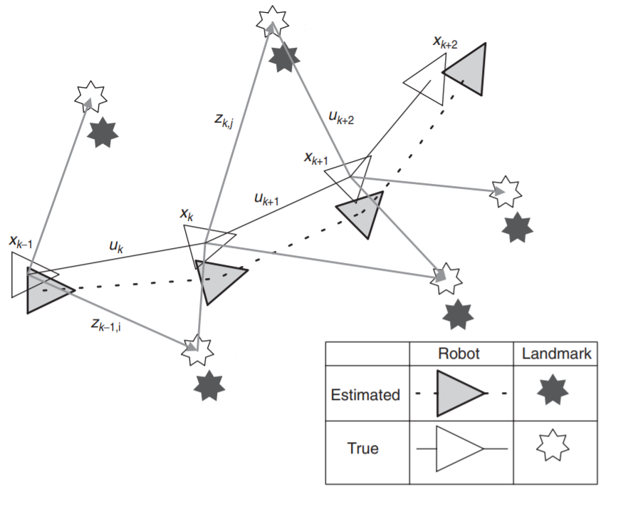
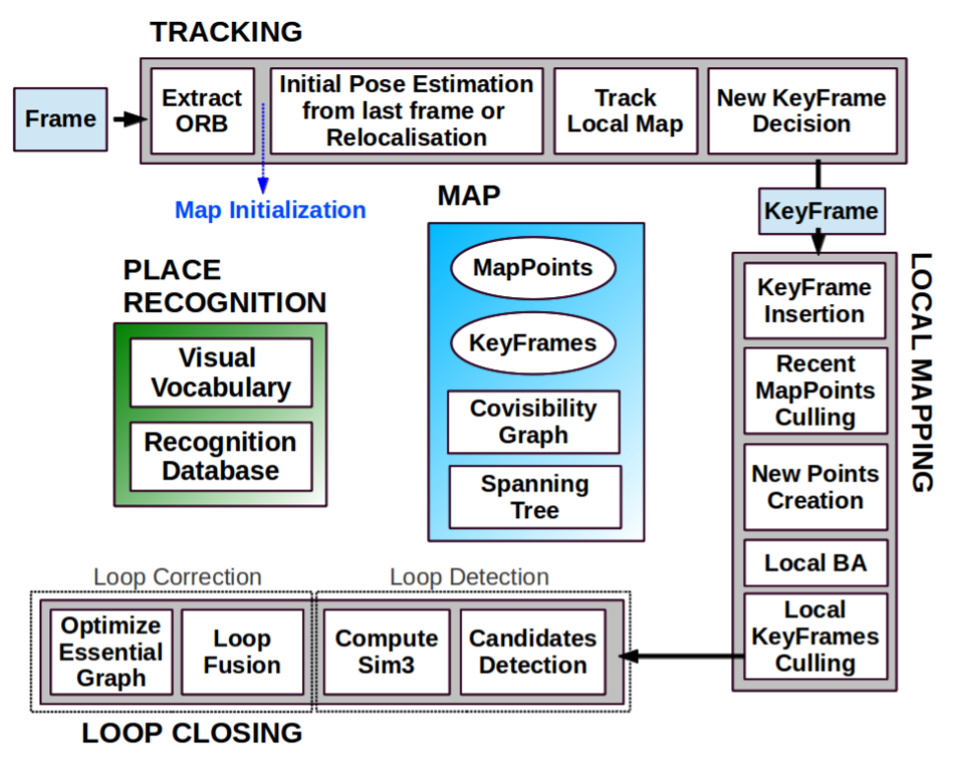
ORB SLAM

Slide 4
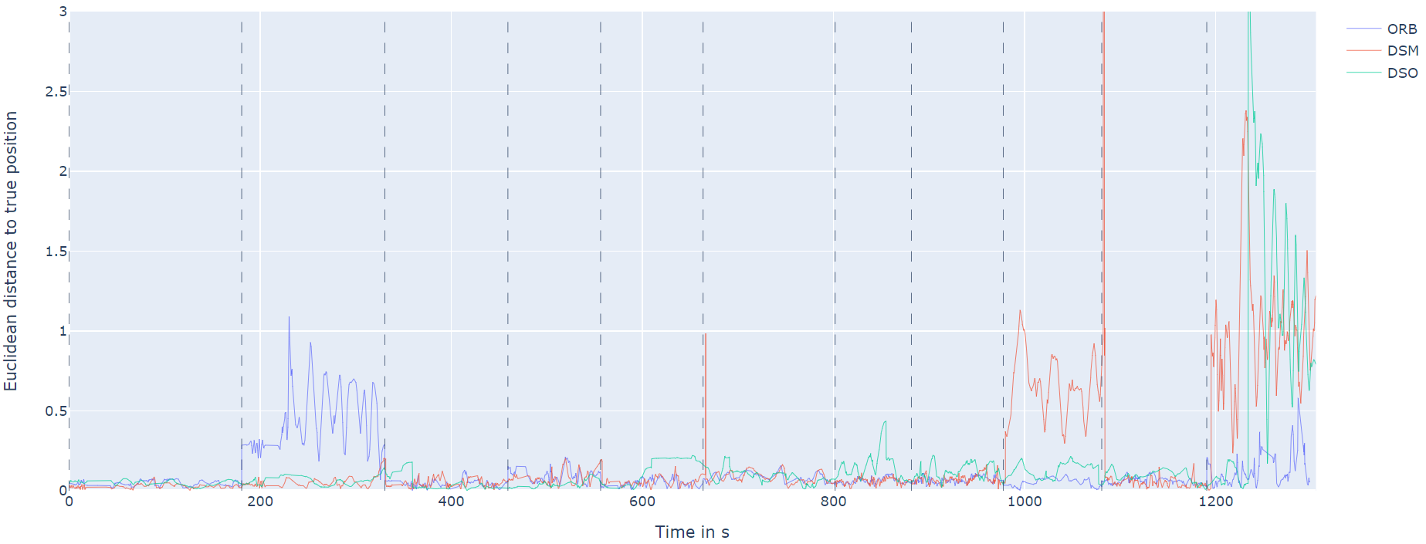
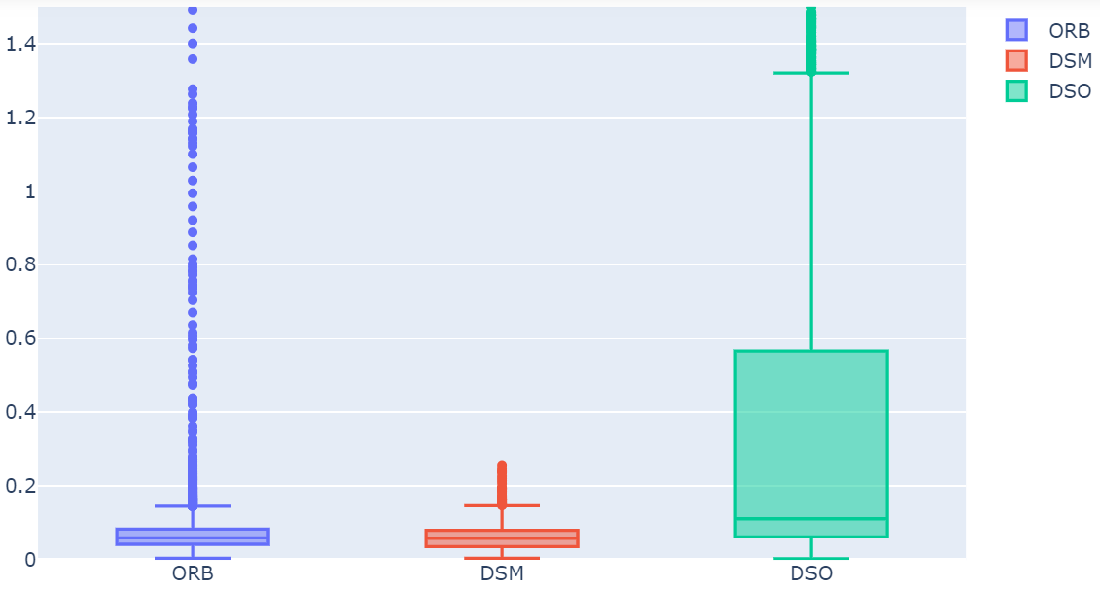
Trajectory Analysis

Slide 5
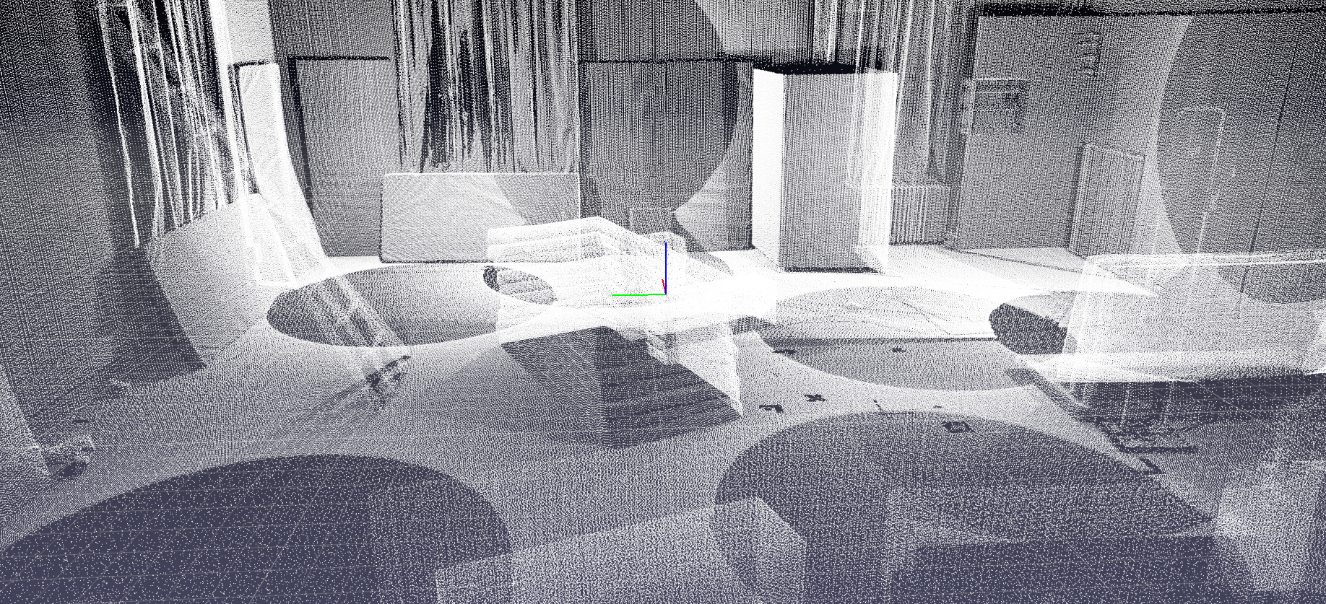
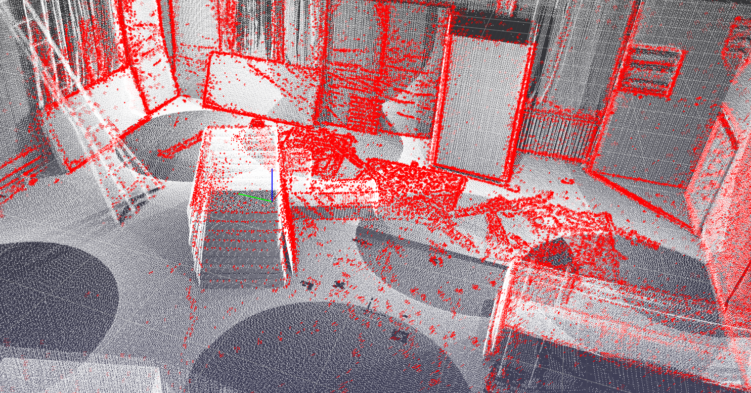
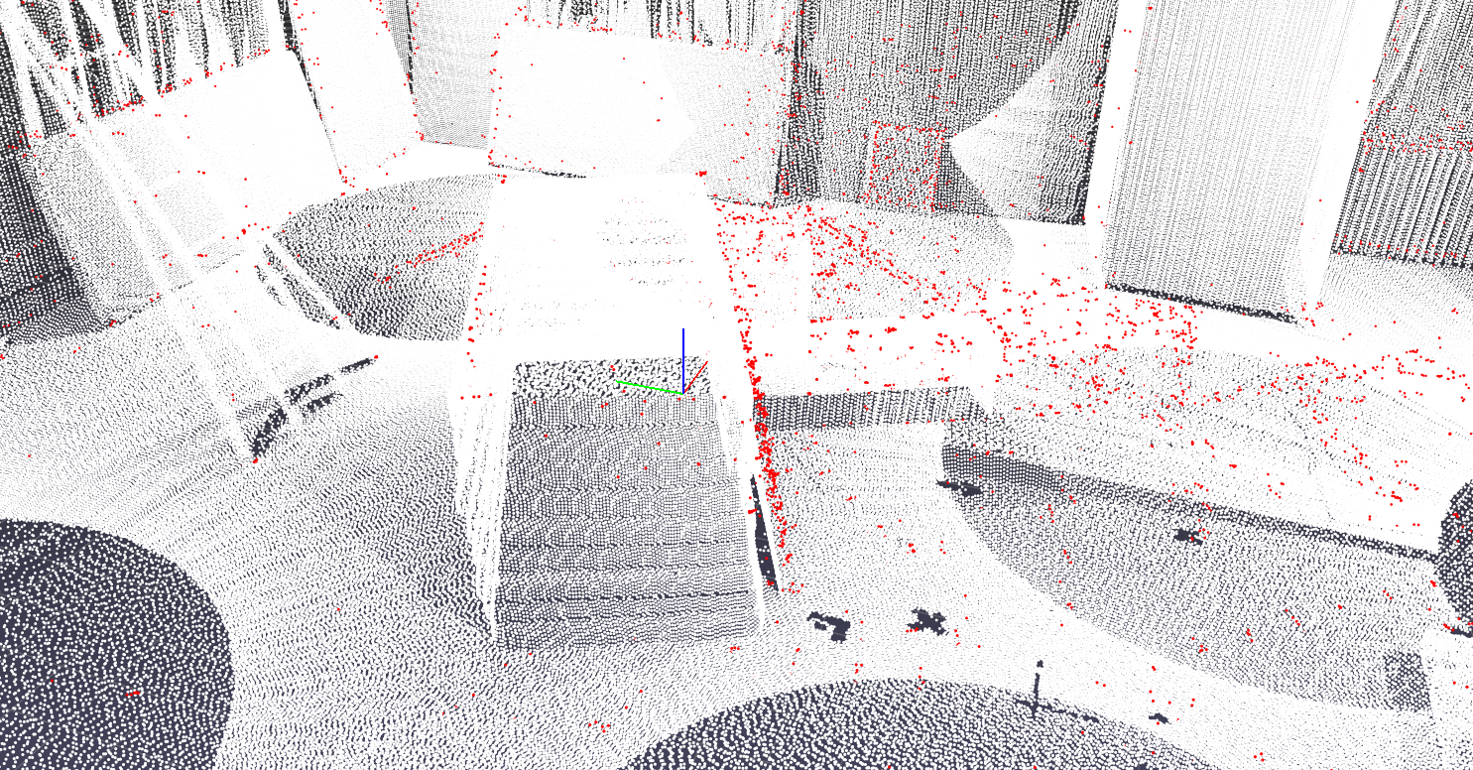
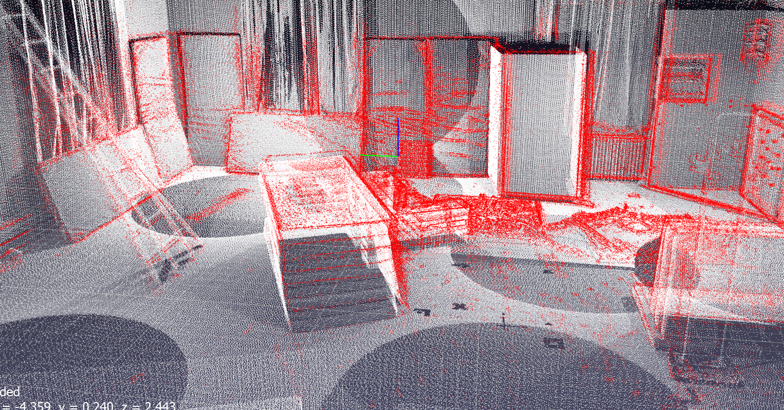
Pointcloud Analysis

Slide 6
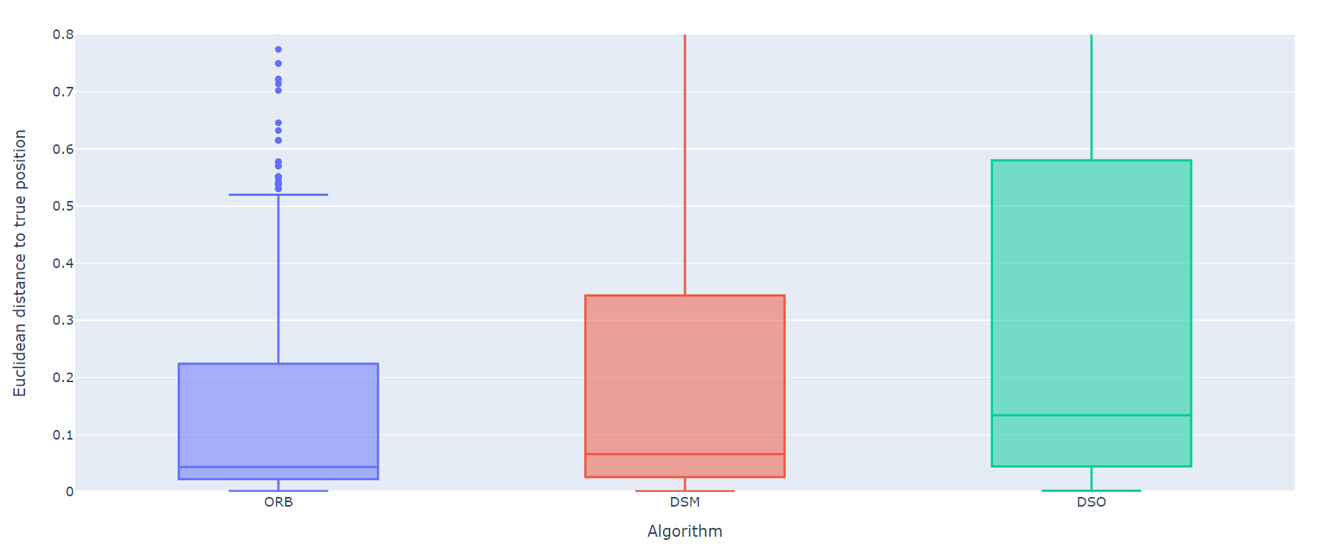
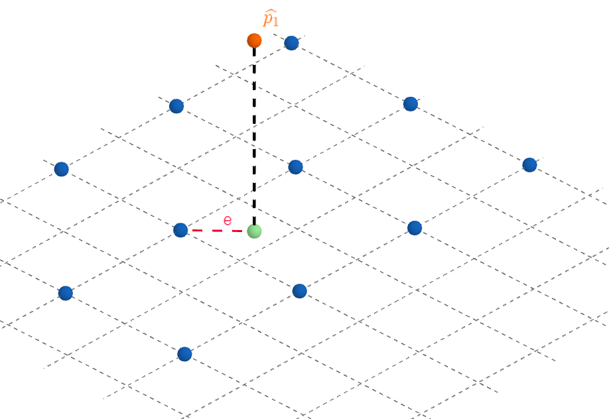
Pointcloud Analysis

Slide 7
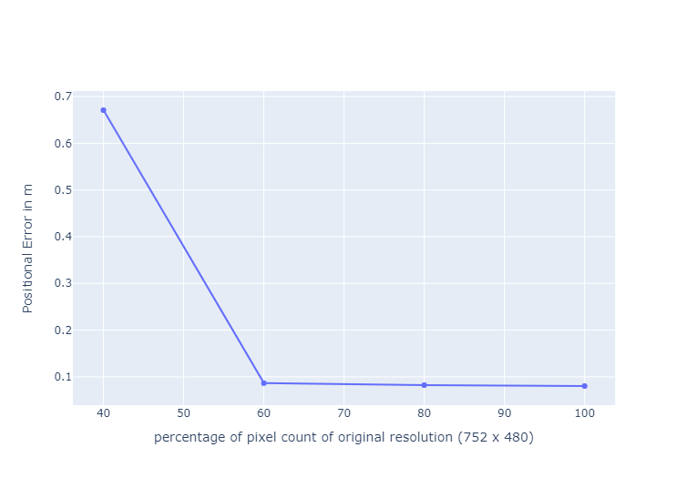
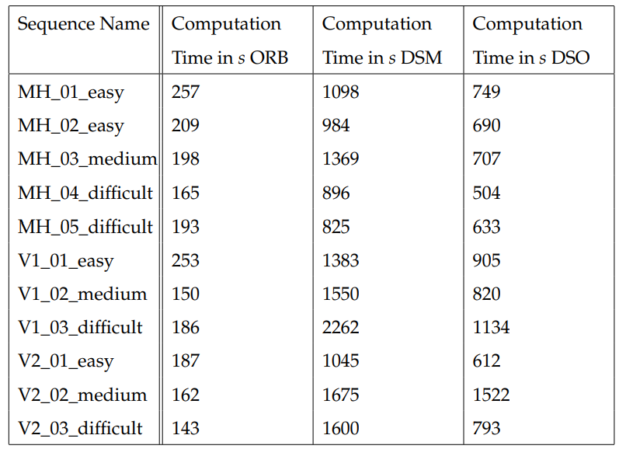
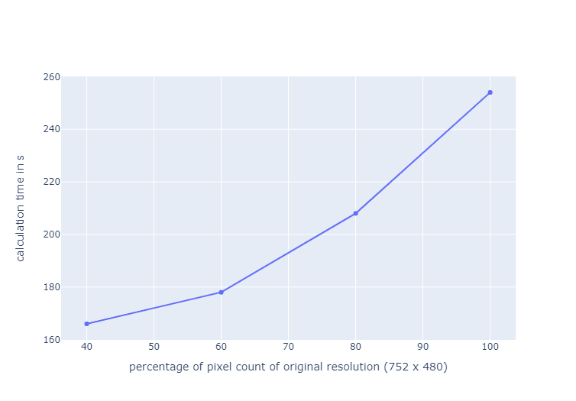
Computational Time

Slide 8
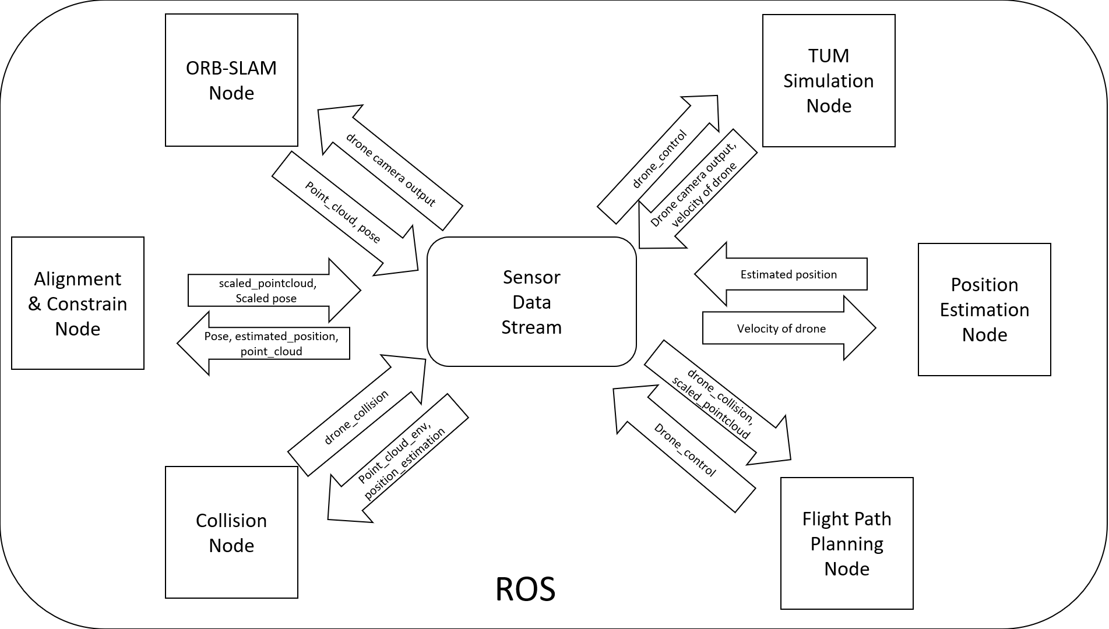
2. Simulated Environment

Slide 9
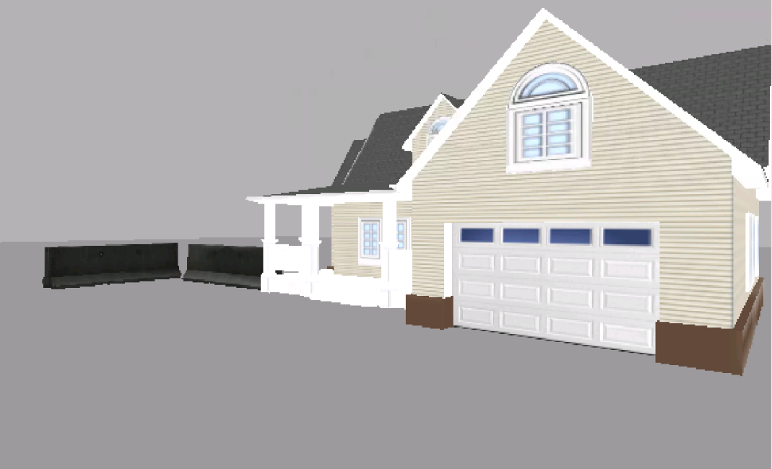
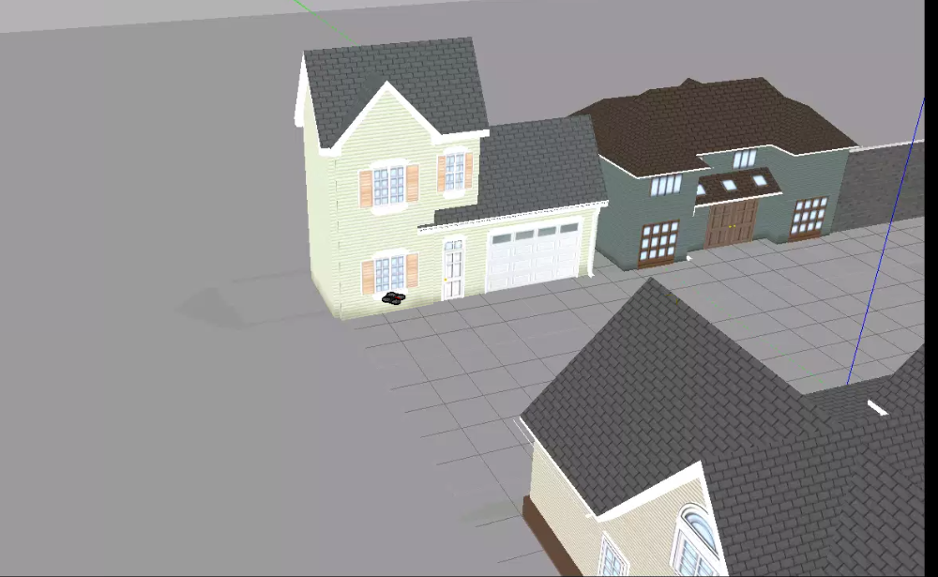
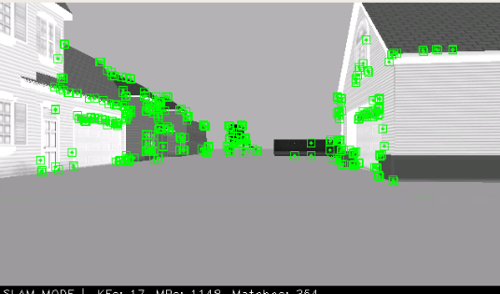
2. Simulated Environment

